Slide 1
Introduction to Java
School of Computer Engineering and technology

Slide 2
Module 1 - Overview
Why Java?
Java Infrastructure
Basic Programming Constructs in Java
OO Concepts
OOP in Java

Slide 3
Why Java?
Closer to English-like syntax than C++
Platform-independent (Platform = Architecture + OS) => hence, WORA
Fully object-oriented
Extensive set of pre-built functionality, available as packages
Sophisticated built-in exception handling mechanism
with verbose error reporting
Secure ----- why? (let’s see in a bit)
Easy to learn for application developers

Slide 4
Java Infrastructure
Java Virtual Machine (JVM)
Here comes security!
Java Runtime Environment (JRE)
Java Development Kit (JDK)
Is java compiled or interpreted?
Java Bytecode (IR)

Slide 5
Basic Programming Constructs
Background :
All basic provisions of Java are implemented in the java.lang package
String is a datatype in Java (implemented as a Class)
E.g. String myname = “Rahul”;
Java is case-sensitive and follows camelCasing –
Class names start with an uppercase letter
variables, objects and methods start with a lowercase letter
GOOD NEWS : Java does NOT have pointers!!
Caveat: It has “reference variables” but they are not as troublesome

Slide 6
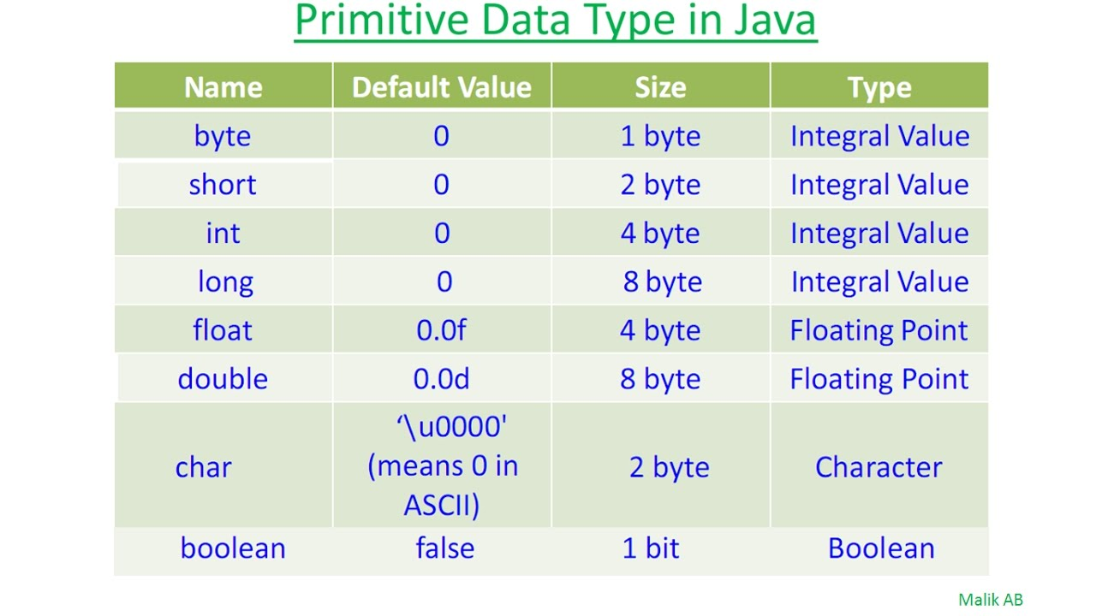
Default values of datatypes
\

Slide 7
Basic Programming Constructs
If-then-else construct
boolean f = true; int a = 1;
if (f) {
//statement 1
}
else {
//statement 2
}
Same goes for a while / do-while loop in Java
ILLEGAL IN JAVA
if (a) {
//statement 3
}
else {
//statement 4
}

Slide 8
Basic Programming Constructs
The switch-case construct
String day = "Tuesday";
switch(day)
{
case "Sunday":
System.out.println("Kal Monday hai");
break;
case "Saturday":
System.out.println("2 din ki chhutti");
break;
default :
System.out.println("Wait for the weekend");
break;
}
Do we need this break?

Slide 9
Basic Programming Constructs
The for-loop in Java is exactly the same as that in C/C++.
The for-each loop:
float arr [] = new float [5];
for (int i = 0; i<5; i++) { //Here i takes the indices of the array
arr[i] = 2*float(i);
}
for (float i : arr) { //Here i takes the values in the array
System.out.println(i);
}
As you can see, array declarations in Java are lengthy!
Can we use the for-each loop here?

Slide 10
Important Sidenote: Initialisation of Arrays
Animal[] arr; // nothing
arr = new Animal[4]; // only array of references
for (int i=0; i < arr.length; i++) {
arr[i] = new Animal();
}
// now we have a complete array of 4 objects of // Animal type

Slide 11
Object-Orientation in Java : The Basics
Class
object
“methods” – not functions
NO FRIEND FUNCTIONS!
Every method has to be in a class; even the main method!
main is usually declared as PSVM public static void main (String[] args)

Slide 12
The Hello World program in Java
public class MainClass {
public static void main (String[] args) {
System.out.println("Hello World");
}
}
// import java.lang; is implicit
#include <iostream>
using namespace std;
int main()
{
cout << "Hello World\n";
}

Slide 13
User I/O in Java
Output:
System.out.print(“whatever you want to print\n”);
System.out.println(“whatever you want to print”);
Input:
Requirement – import java.util.Scanner;
Use – Scanner kb = new Scanner(System.in);
String word = kb.next();
String sentence = kb.nextLine();
int i = kb.nextInt();
char c = kb.nextChar();
Now alter the Hello World program to read the user’s name and then say Hello to the user.

Slide 14
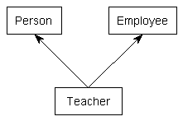
Going ahead with OOP in Java
OOP concepts supported by Java:
Classes (and obviously, objects)
Interfaces – a special type of classes
Inheritance – but NOT multiple inheritance
Polymorphism:
method overloading
method overriding
Java does not support user-defined operator overloading. However, it has internally overloaded operators. (e.g. +)
ILLEGAL IN JAVA
Caveat: Interfaces can overcome this!

Slide 15
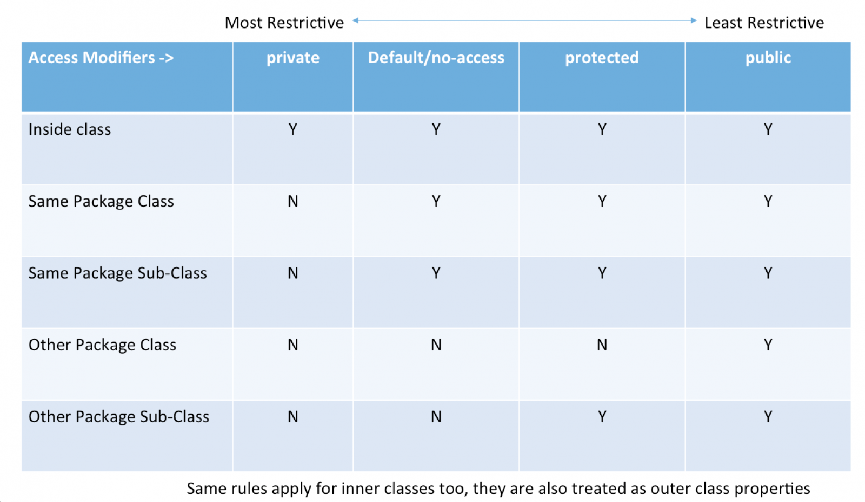
Going ahead with OOP in Java
Concept of a package
Security:
private
public
protected
default (not specified)

Slide 16
Let’s create a class!
class TeaPot {
private static int numOfTeaPots = 0;
private String teaPotColor;
public TeaPot (String c) {
teaPotColor = c;
numOfTeaPots++;
}
public static int howManyTeaPots()
{ return numOfTeaPots; }
public String getColor()
{ return teaPotColor; }
}
public class MainClass {
public static void main (String[] args) {
TeaPot tp1 = new TeaPot (“Red”);
TeaPot tp2 = new TeaPot (“Green”);
System.out.println(tp1.getColor());
System.out.println(tp2.getColor());
int num = TeaPot.howManyTeaPots();
System.out.println(“No of teapots =”);
System.out.println(num);
}
}

Slide 17
Let’s inherit!
class Base {
void printClassName() {
System.out.println(“Base”);
}
}
class Derived extends Base {
void printClassName() {
System.out.println(“Derived”);
}
}
public class MainClass {
public static void main (String[] args) {
Base b1 = new Base();
Derived d1 = new Derived();
Base b2 = new Derived();
b1.printClassName();
d1.printClassName();
b2.printClassName();
}
}
Notice the overridden method.

Slide 18
Polymorphism and the super keyword
class Base {
void printClassName() {
System.out.println(“Base”);
}
void printClassName(int n) {
System.out.println(“Base_” + n);
}
}
class Derived extends Base {
void printClassName() {
System.out.println(“Derived”);
}
void printClassName(int n) {
super.printClassName(n);
}
}
public class MainClass {
public static void main (String[] args)
{
Base b1 = new Base();
Derived d1 = new Derived();
b1.printClassName();
b1.printClassName(1);
d1.printClassName();
d1.printClassName(2);
}
}

Slide 19
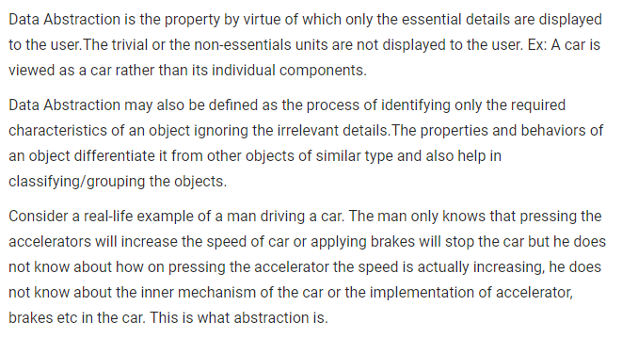
Food for thought: ABSTRACTION

